Slide 1
“Flight Price Prediction” - A Regression Analysis

Slide 2
Contents :
Objective
Dataset description
Pre-processing of data
Building various model
Deciding best model
Conclusion

Slide 3
Objective :
The objective of this Project is to predict flight prices given the various parameters. This will be a regression problem since the target or dependent variable is the price (continuous numeric value).
Business Scenario :
Airline companies use complex algorithms to calculate flight prices given various conditions present at that particular time. These methods take financial, marketing, and various social factors into account to predict flight prices.
Nowadays, the number of people using flights has increased significantly. It is difficult for airlines to maintain prices. since prices change dynamically due to different conditions. That’s why we will try to use machine learning to solve this problem. This can help airlines by predicting what prices they can maintain. It can also help customers to predict future flight prices and plan their journey accordingly.

Slide 4
Dataset Description
Source: https://www.kaggle.com/nikhilmittal/flight-fare-prediction-mh
I’m using jupyter-notebook to run Flight Price Prediction task.
Number of variables = 11
Number of rows = 10683
Number of categorical type of feature = 10
Number of numerical type of feature = 1
Detail description of each variable :
Airline → Name of the airline used for traveling
Date_of_Journey → Date at which a person travelled
Source → Starting location of flight
Destination → Ending location of flight
Route → This contains information on starting and ending location of the journey in the standard format used by airlines.
Dep_Time → Departure time of flight from starting location
Arrival_Time → Arrival time of flight at destination
Duration → Duration of flight in hours/minutes
Total_Stops → Number of total stops flight took before landing at the destination.
Additional_Info → Shown any additional information about a flight
Price → Price of the flight

Slide 5
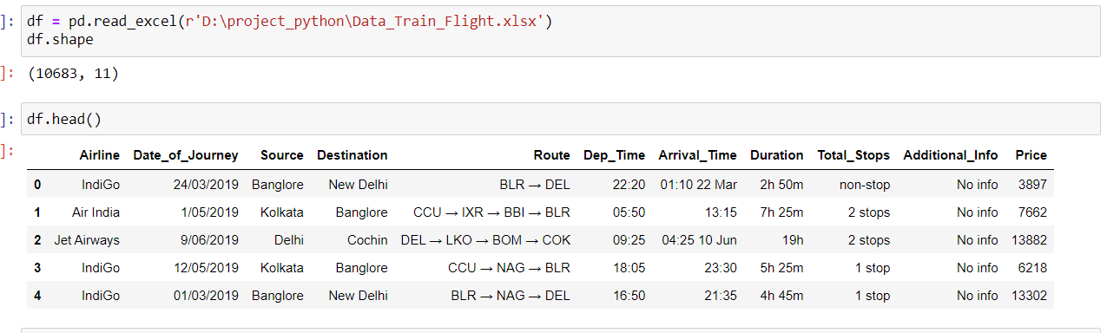
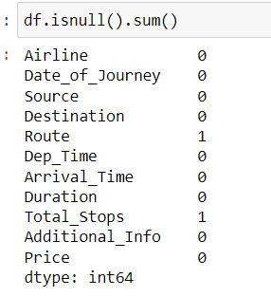
Import dataset :
Checking null values :
Route & Total_Stops in these two column only 1 null value is there , so I drop it .

Slide 6
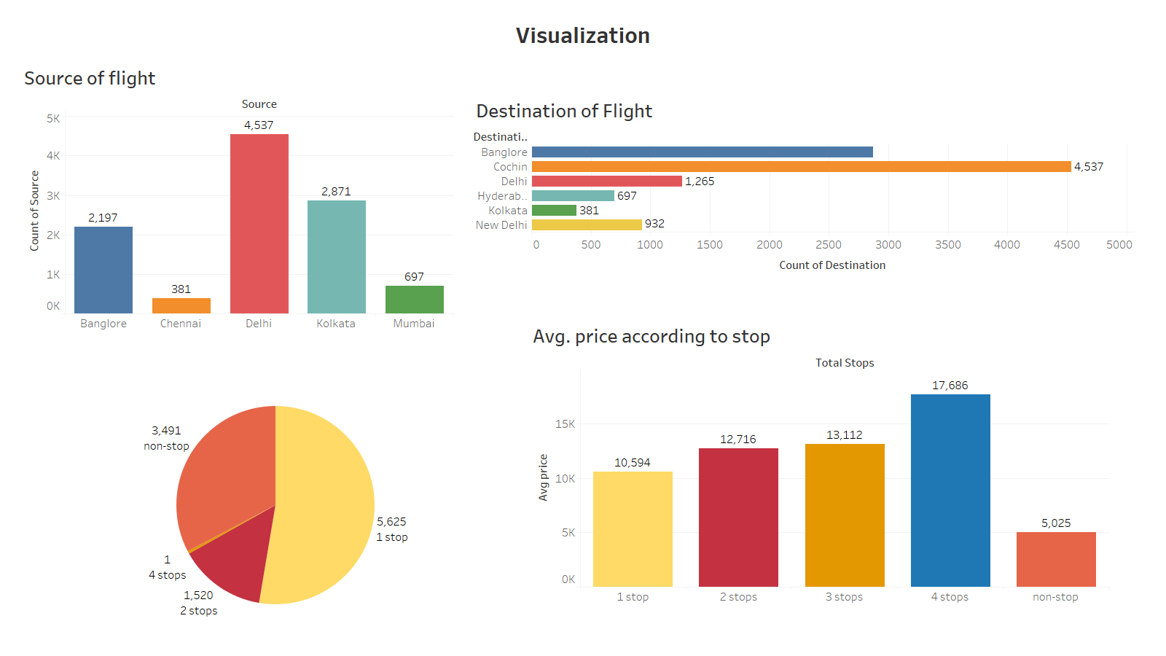
Total Stops

Slide 7
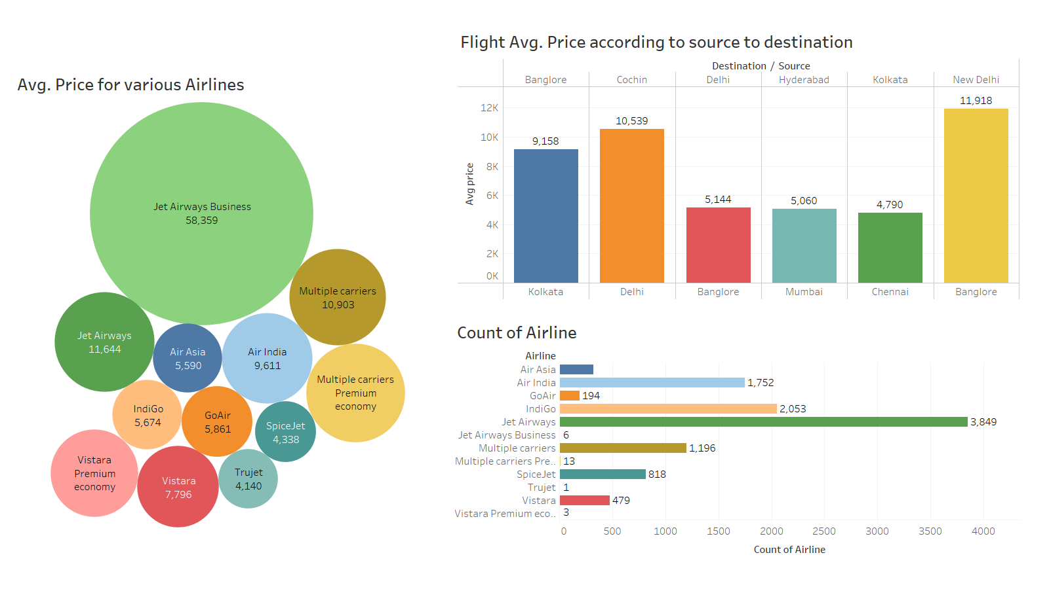

Slide 8
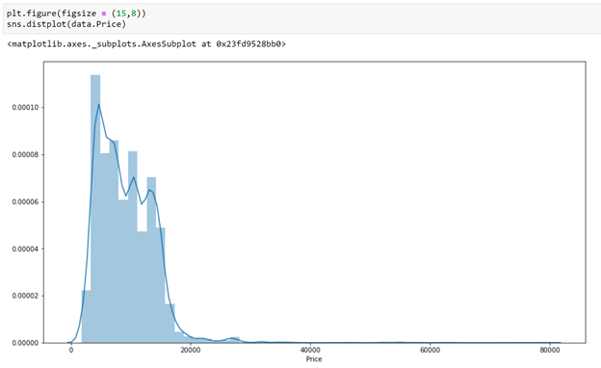
Distribution of ‘Price’ column
The price column contains the minimum value as 1759 and maximum value as 79512.
Majority of the flights have price range between 1759–20k, and number of flights having prices
greater than 20k are quite less. Price range is skewed towards right.

Slide 9
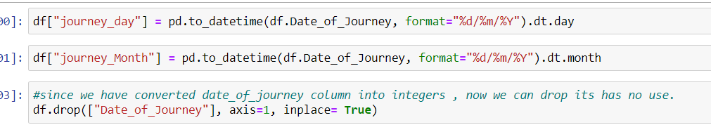
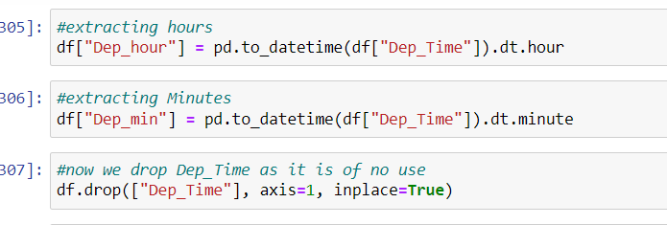
Feature Engineering:
Date_of_journey is a object data type, therefore, we have to convert this datatype into timestamp so has to use this column properly for prediction
Departure time is when a plan is leaves the gate. similar to date_of_journey I had extract values from Dep_Time .

Slide 10
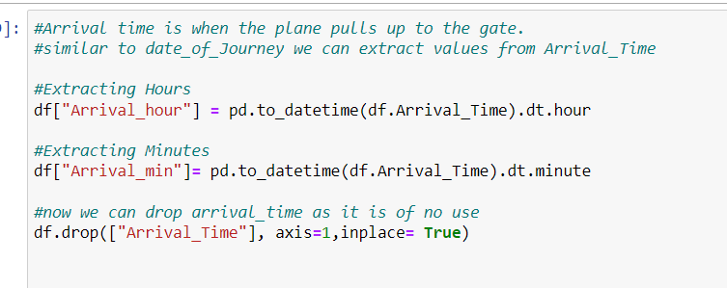
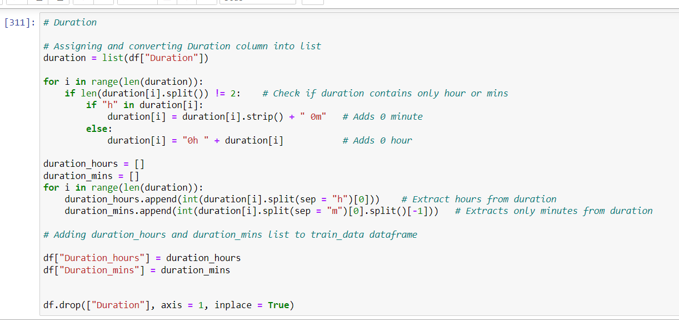
Arrival time is when the plane pulls up to the gate. similar to date_of_Journey I had extract values from Arrival_Time .
From Duration column I had extract the Duration_hours & Duration_mins

Slide 11
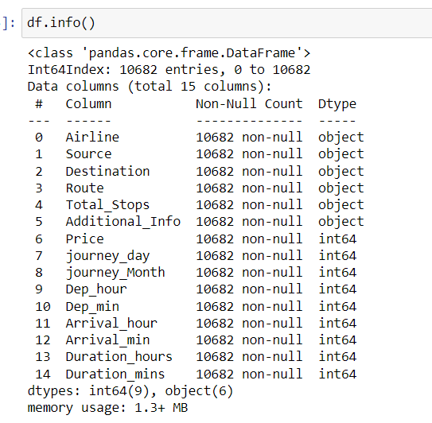
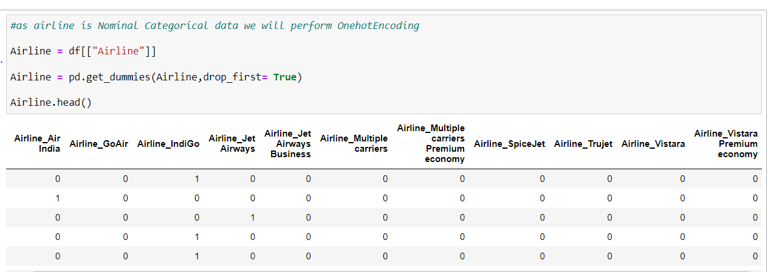
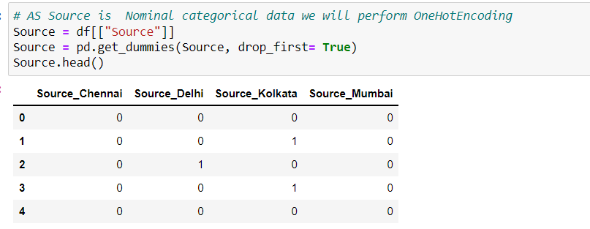
Categorical data : Some ways of handle categorical data are, Nominal data --> data are not in any order --> OneHotEncoder is used in this case Ordinal data --> data are in order --> LabelEncoder is used in this case

Slide 12
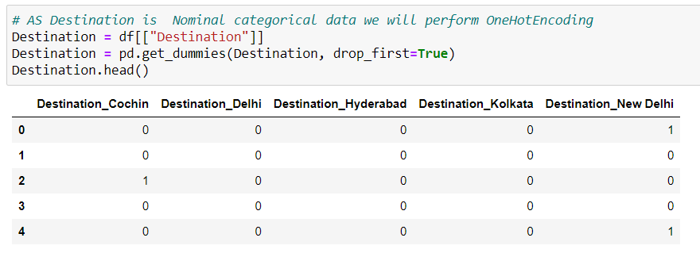
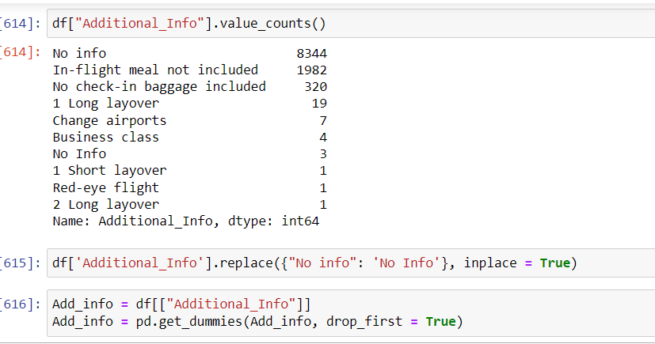

Route variable represents the path of the journey.
Since the ‘Total_Stops’ variable captures the information if the flight is direct or connected
so I have decided to drop this variable.

Slide 13
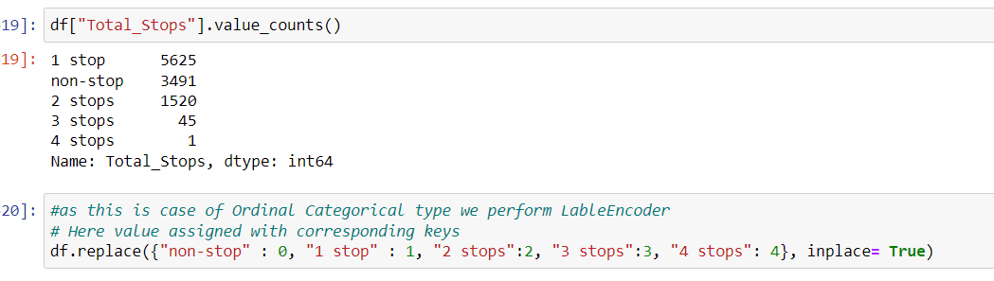
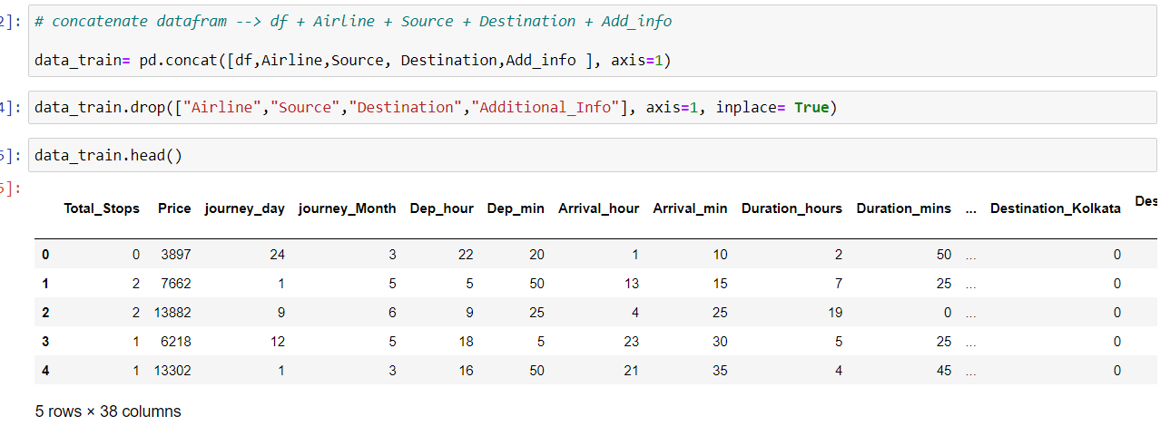
Here, non-stop means 0 stops which means direct flight. Similarly meaning other values is obvious.
We can see it is an Ordinal Categorical Data so we will use LabelEncoder here to handle this variable.
Now we will create the final dataframe by concatenating all the One-hot and Label-encoded features
to the original dataframe. We will also remove original variables using which we have prepared new encoded variables.

Slide 14
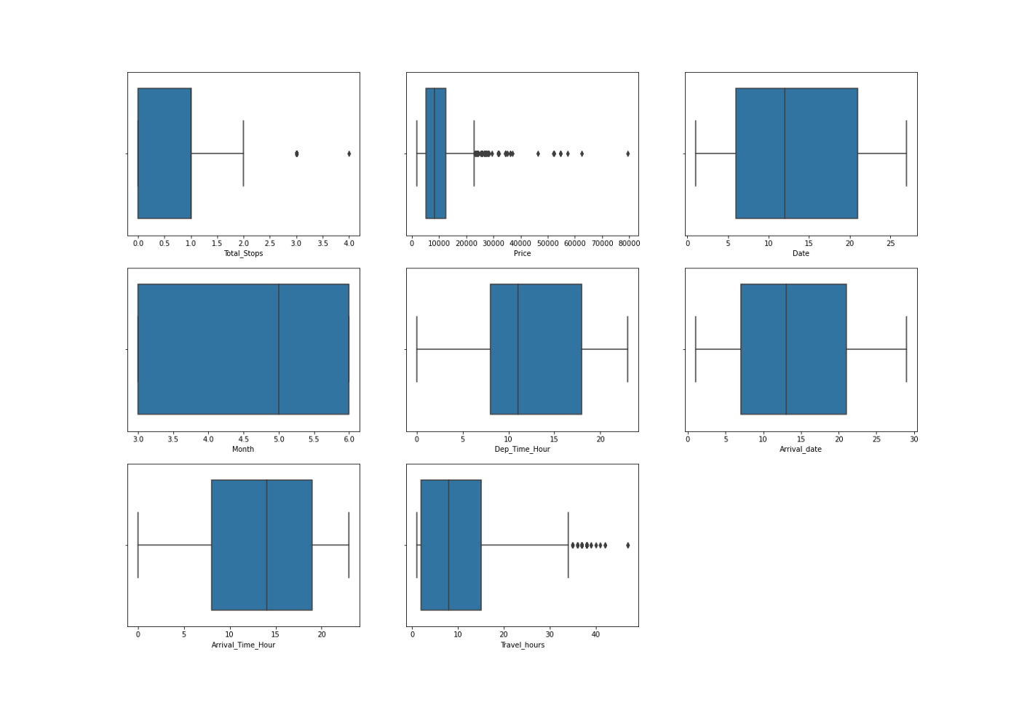
Outlier detection:-
Now plot boxplots to check the presence of outliers in our data –
We make the below conclusions –
- Outliers are present in Total hours, Total stops and price
- We will not remove outliers from total stops since price is impacted by number of stops
We will not remove the data with high number of hours, increase in number of hours shows a price pattern in the above graphs plotted for EDA.

Slide 15
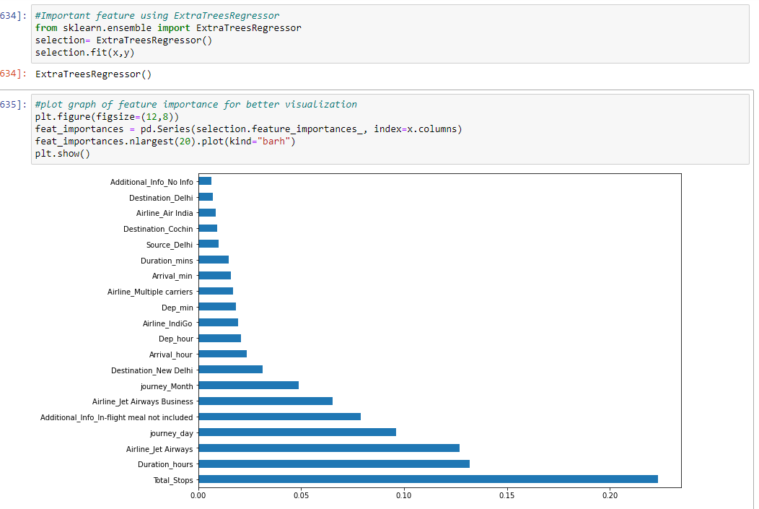
Feature selection :

Slide 16
Model Building
Now proceed to the main step of our machine learning, fitting the model and predicting the outputs. We fit the data into multiple regression models to compare the performance of all models and select the best model
Linear regression
Regularization techniques : Lasso & Ridge
Decision Tree regressor
Random Forest regressor
Ada-Boost regressor
Gradient Boosting regressor
XGBRegressor

Slide 17
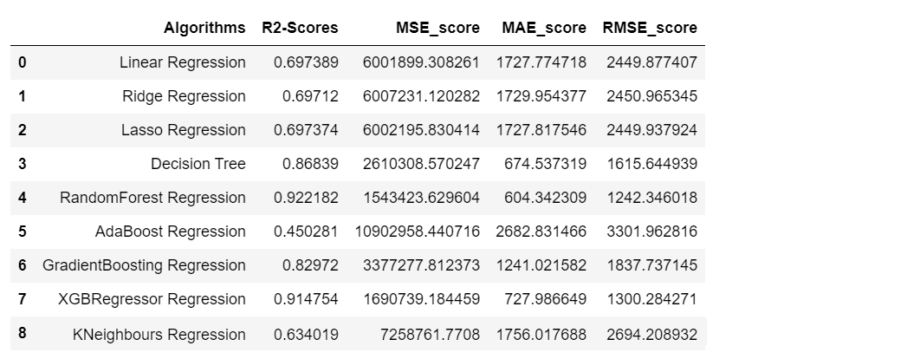
Deciding the best model
Here I collect all R2_score , MSE , MAE , RMSE score on test dataset.

Slide 18
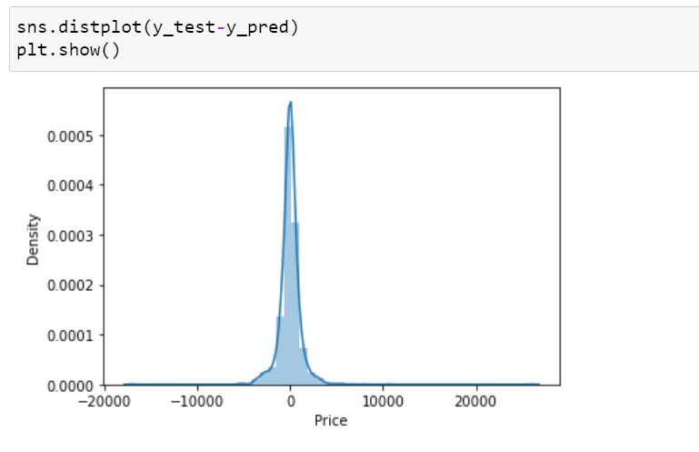
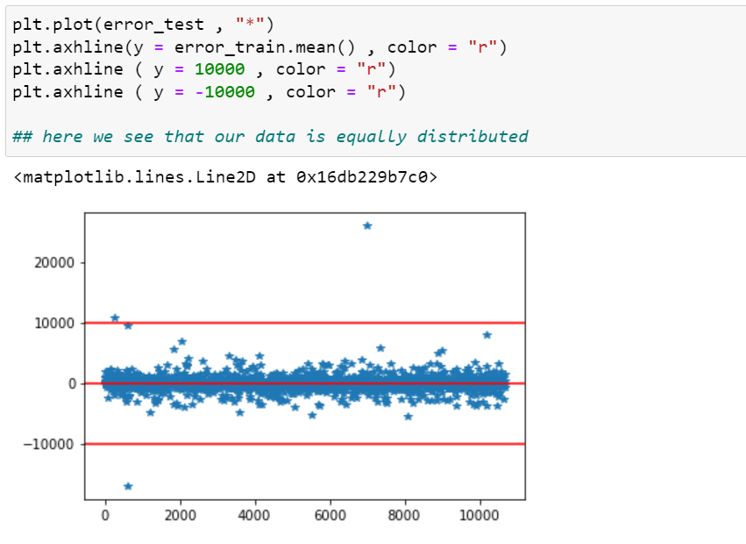
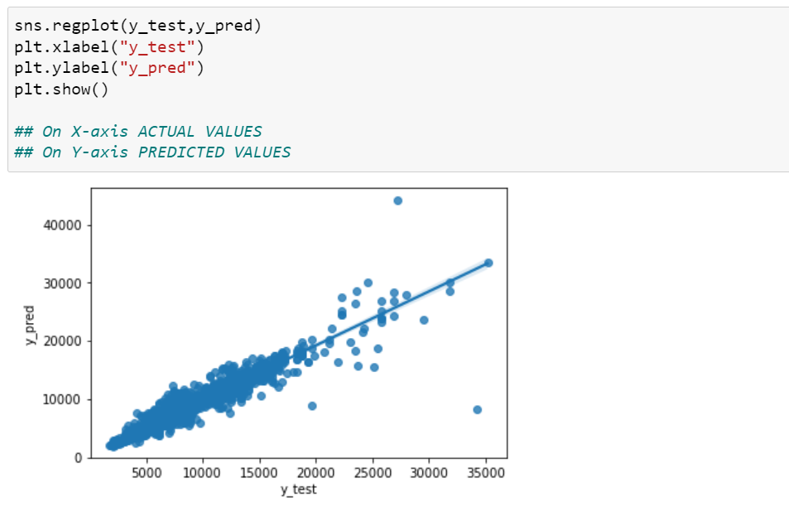
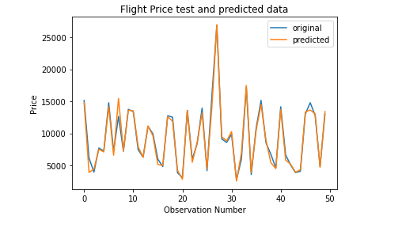
Plot on Random forest
Error Normally distributed
Variance around the regression line is same to all predicted value
Almost predict same original and predicted value

Slide 19
Conclusion :
As per all models performance. My conclusion is for this dataset ‘Random forest model’ is best.it gives best result and also best predict the flight’s prices. After comparing all models “Random Forest Model” gives r2_score 92%.Which is very good. Also error terms are normally distributed.
A proper implementation of this project can result in saving money of inexperienced people by providing them the information related to trends that flight prices follow and also give them a predicted value of the price which they use to decide whether to book ticket now or later. In conclusion this type of service can be implemented with good accuracy of prediction.

Slide 20
THANK YOU !

